Slide 1
Getting Started
We know it’s the little things that can make all the difference
A Guidebook for Those Setting the Foundation
(Built for individuals in their 20’s, 30’s)

Slide 2
Where you Are
You are just starting out and are interested in guidance regarding the type of accounts to open, 401(k) questions and how to prioritize goals such as down payment for house, emergency fund, car purchase, etc. OR perhaps you have been in the workforce for a little while but need to get a handle on your finances and prioritize where you should be directing your money.

Slide 3
KNOW WHERE YOUR MONEY GOES
Almost two-thirds of millennials say they’re living paycheck to paycheck and only 38% feel financially stable, according to a new survey from Charles Schwab.
Millennials also say they spend an average of $478 a month on “nonessential” purchases, such as dining out, entertainment, luxury items and vacations.
Pew Research Center found that the median amount of loan debt millennials carried was $19,000.
About 40% of millennials (defined here as those 20 to 35 years old) have credit card debt, according to a recent survey by LightStream, the online lending division of SunTrust Bank.
https://www.cnbc.com/2019/05/10/62-percent-of-millennials-say-they-are-living-paycheck-to-paycheck.html
https://www.forbes.com/feature/millennial-money/#2051fed24799 (look at this and model for future slides)
Use our cash flow template. Available upon request via phone call or email.

Slide 4
Track your progress year to year
Your net worth can be a great tool in gauging your overall financial progress from year to year.
Your net worth is the figure you get when you add up everything you own (value of your home to the cash in your bank account) and then subtract all your debts (this may include a mortgage, car or student loans and credit card balances).
Essentially, it is what you would have left if you sold everything you owned and paid off all of your debts.
To learn more CLICK HERE
Use our net worth template. Available upon request via phone call or email!

Slide 5
Financial goals & Milestones to aim for
•Create a budget and track spending. Consider using the 50/30/20 guideline (50% of your income goes towards needs, 30% goes towards wants and 20% goes towards debt payments/savings/investing).
•Consider renter’s insurance. It pays to replace your stuff due to things like fire or a burst pipe but also covers theft and the cost to stay somewhere else if your apartment is temporarily unavailable. It is about $15/month.
twenties
•Start putting money away for an emergency fund. You should have at least 3 month’s- worth of expenses saved up.
•Start contributing to your employer sponsored retirement account such as a 401(k) or 403(b). Stash away 10% of your annual salary. If you can’t put aside this much, choose a lesser amount but increase it every year. Take advantage of any company matching opportunities! If your workplace doesn’t have one, open a traditional IRA and begin making monthly contributions. Automate the contributions.
•Plan to pay off debt (high interest credit card debt and student loans).
•Save before you buy. Make smart financial decisions. If it isn’t broken, why buy a new one?
Budgeting resources
Mint: https://www.mint.com/
YNAB: https://youneedabudget.com/
Good Budget: https://goodbudget.com/
Every Dollar: https://everydollar.com/

Slide 6
Financial goals & Milestones to aim for
thirties
•Completely eliminate student loan debt and high interest credit card debt if you haven’t already.
•Save at least 15% of every paycheck.
•Have at least 1X your annual income in retirement savings.
•Increase your savings rate with every raise or bonus and at the very least with every new year. Try to start or continue to max out your 401(k).
•Consider saving for a down payment on a home.
•Establish a will and update it every year.
•Start an investment portfolio (once you’ve eliminated debt and secured an emergency fund). Use money you won’t need within the next 5 years.
Student loan resources
Coronavirus and Forbearance Information for Students, Borrowers, and Parents
Student Loan Refinancing Calculator
Student Loan Consolidation

Slide 7
Financial goals & Milestones to aim for
forties
•Ensure you have eliminated all non-mortgage consumer debt.
•Have a plan for your kid’s college (perhaps open a 529 plan and make monthly automatic contributions). However, prioritize retirement savings first. Rule of thumb: multiply your child’s age by 2,000 and this is the amount you should have saved by now (assumes 4-year public college and covering half of the cost).
•Continue saving. Contribute 10-15% of your annual salary to your retirement accounts – 401(k), 403(b), IRAs.
•Have at least 2X – 3X your annual income in retirement savings.
•Consider the benefits of opening a ROTH IRA.
•Consider opening a taxable investment account that can be used in the early retirement years as your tax-deferred account.
•Avoid lifestyle inflation.
Other Helpful Resources
Financial Calculators
Recommended Reading
Web Resources

Slide 8
Millennial checklist
Insurance
Review deductibles and coverages to ensure properly covered.
Consider obtaining renter’s insurance if renting property.
Consider obtaining umbrella policy.
Financial planning/investment planning
Consider hiring Main Street Advisors, LLC to help you create a financial plan, help you create a budget, create a debt reduction plan and invest your money wisely.
Create a net worth sheet to track your financial progress from year to year.
Invest in a 401(k), 403 (b) and/or IRA for retirement savings.
Create an emergency fund (3 months of expenses)
Start contributing to a 529 plan if you have children
Estate planning
Secure a financial power of attorney, health power of attorney and last will and testament

Slide 9
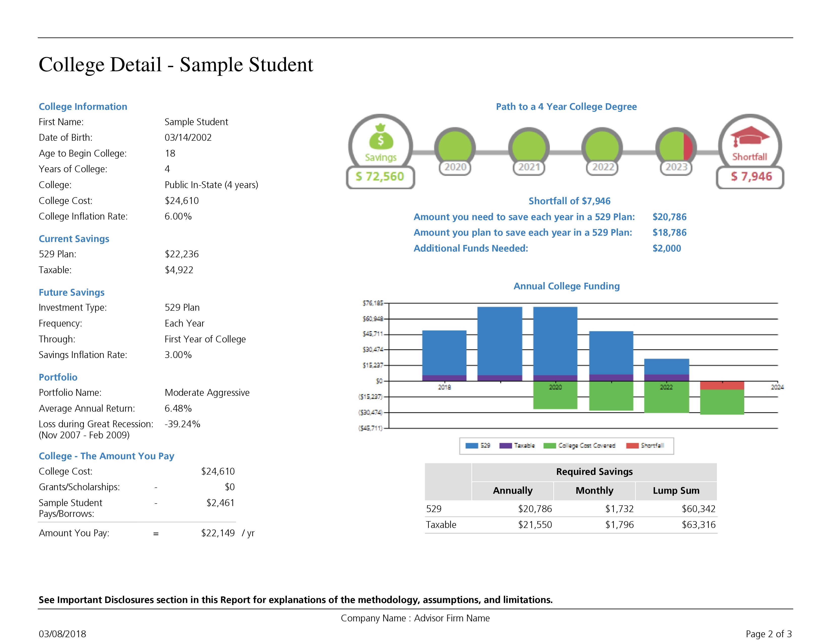
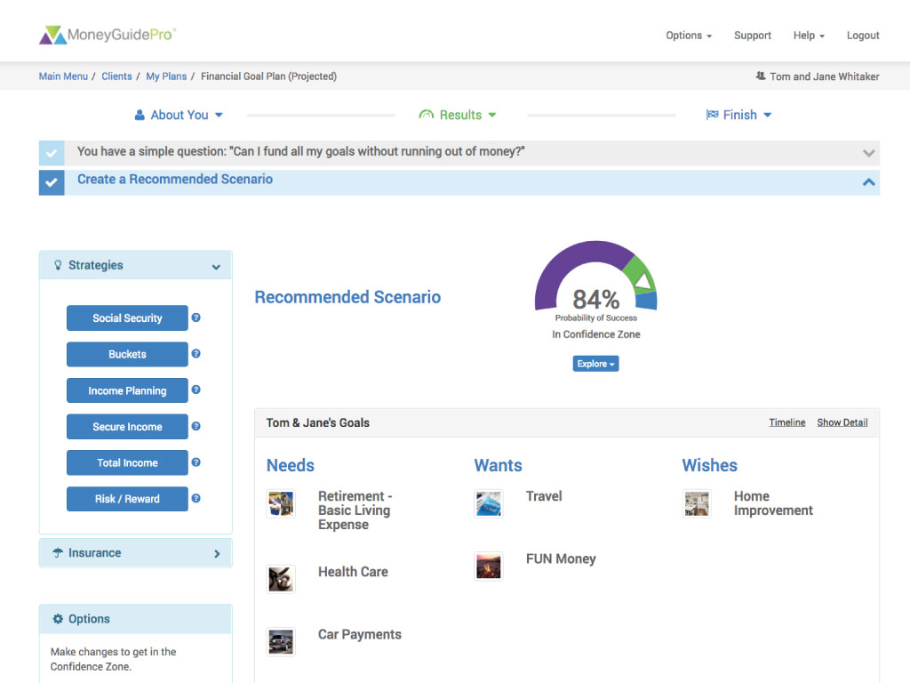
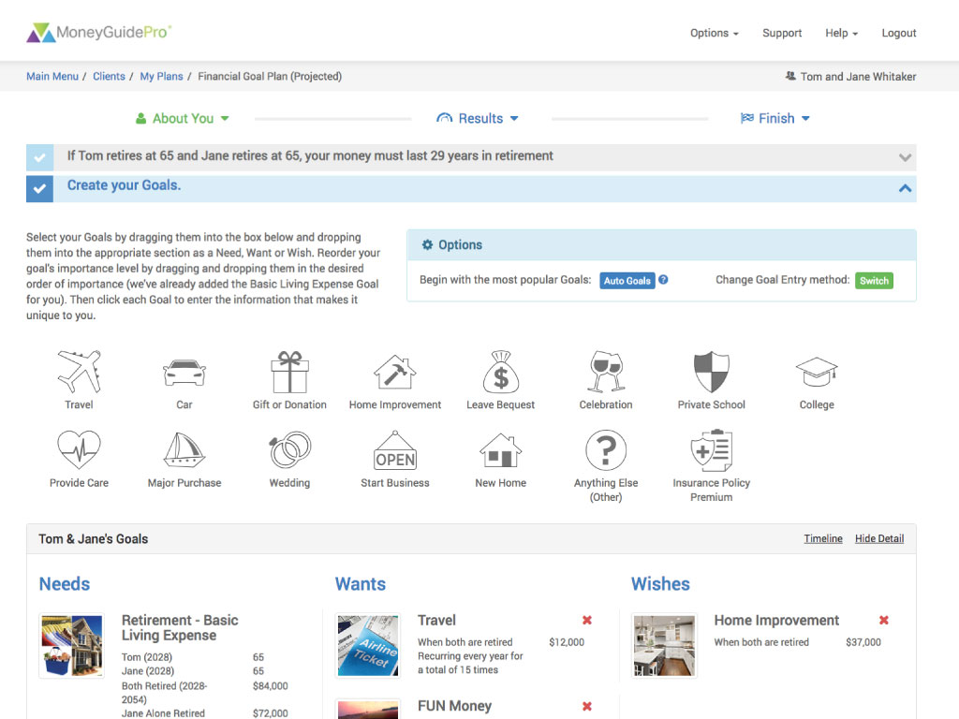
Life is full of decisions emanating from many different areas: charitable giving, education planning, investment planning, estate planning, retirement planning, social security claiming strategies, tax reduction, risk management, cash flow/income sourcing and more.
The complex nature of these initiatives and the way in which they are interlinked causes each one to have a significant impact on the other, which requires a comprehensive solution tailored specifically to the individual client. To help us achieve this, we utilize one of the industry’s leading financial planning software programs, MoneyGuidePro®.
This enhanced solution gives us the ability to offer varying degrees of plans ranging from a more targeted perspective focusing on specific areas such as retirement planning or college planning to a more comprehensive approach, encompassing every area of your financial life. This tool affords our clients the ability to visually see the financial impact their decisions can have on their short and long-term goals, and ultimately overall financial future.
VISIT OUR WEBSITE TO LEARN MORE

Slide 10
Hope to hear from you soon!
CFP@mainstadvisors.com
https://www.mainstadvisors.com
410-840-9200

Slide 11
Thank you!
CC
Connect with us!
f
in
Hometown Service | Thoughtful Solutions | Powerful Results. We know it’s the little things that can make all the difference.
Main Street Advisors, LLC is a Registered Investment Advisor. The articles & opinions expressed in this material were gathered from multiple sources, but are reviewed by Main Street Advisors, LLC prior to its dissemination. All sources are believed to be reliable but do not constitute specific investment advice. The views expressed are those of the firm as of the date of the material being shared and are subject to change. These opinions are not intended to be a forecast of future events, a guarantee of results, or investment advice. Information shared is general in nature. Investors must consider their own individual circumstances and seek appropriate counsel from their investment advisor before making any investment choices. Main Street Advisors, LLC is not responsible for any damages or losses arising from any use of this information. Past performance is no guarantee of future results.

