Slide 1
Getting Started
We know it’s the little things that can make all the difference
A Guidebook for Those in the Distribution Phase of Life
(Built for individuals in their 60’s and beyond)

Slide 2
Where you Are
You are either beginning, or you’re very close to starting, to draw retirement income from your assets. You have questions relating to Social Security claiming strategies, Medicare options, tax strategies, estate planning, how the timing of certain goals will effect your overall retirement projection and more…

Slide 3
KNOW WHERE YOUR MONEY GOES
According to a survey by the Transamerica Center for Retirement Studies, the median retirement savings in the U.S. for Americans in their 60’s is $172,000, which is alarming.
The average Social Security retirement benefit is about $1,543/month or about $18,516/year, according to the AARP. However, the average retiree household pays an average of $17,472/year ($1456/month) on housing expenses alone (mortgage, rent, property taxes, insurance, maintenance and repairs). According to the latest consumer expenditure survey from the U.S. Bureau of Labor Statistics, the average retiree household spends $50,220/year. And a recent study by Fidelity revealed a U.S. couple retiring in 2021 at age 65 needed $300,000 of savings to cover future medical costs.
Some seniors are forced to retire sooner than expected as a result of late-in-life job loss or health issues. If you have to claim Social Security prior to 70, you may struggle if you don’t have a healthy amount of retirement savings.
According to a survey by Bankrate.com, the biggest financial concerns of retirees are paying for health care, outliving their money, maintaining an income stream to afford daily expenses, and having too much debt.
Aging, reduced income, and increased healthcare costs have caused many to take on debt, however there are signs of improvement, according to the EBRI. The total debt burden for Americans over age 70 increased 543% from 1999 through 2019, to $1.1 trillion, according to the Federal Reserve Bank of New York.
Cutting expenses, working a part-time job, delaying Social Security, eliminating debt and saving/investing are all ways to put you in a better position during retirement. Knowing where your money goes is crucial!
Use our cash flow template. Available upon request via phone call or email.

Slide 4
Track your progress year to year
Your net worth can be a great tool in gauging your overall financial progress from year to year.
Your net worth is the figure you get when you add up everything you own (value of your home to the cash in your bank account) and then subtract all your debts (this may include a mortgage, car loans or credit card balances).
Essentially, it is what you would have left if you sold everything you owned and paid off all of your debts.
To learn more CLICK HERE
Use our net worth template. Available upon request via phone call or email.

Slide 5
Financial goals & Milestones to aim for
sixties
•Look for ways to earn more income (selling stuff on Etsy, part-time side job) and continue to grow your nest egg.
•Review Social Security options and the upside of delaying benefits. Discuss with a financial advisor.
•Estimate healthcare costs for retirement. (According to the Fidelity Retiree Health Care Cost Estimate, an average retired couple age 65 in 2021 may need about $300,000 saved (after tax) to cover health care expenses in retirement.
•Understand how you will be impacted by taxes. Discuss your specific situation with a CPA and financial advisor.
•Understand your options regarding Medicare/Medicaid and Medigap.
•Meet with your estate planning attorney and financial advisor at least annually to ensure documents, goals, investment allocations, beneficiaries, etc. are all up to date and reflecting your current wishes.
•Simplify. Consolidate accounts where prudent to do so.
resources
Social Security Calculator (Financial Engines)
Social Security Calculator (Open Social Security)
Medicare and You Handbook
Medicare Plan Finder
The State Health Insurance Assistance Program

Slide 6
Financial goals & Milestones to aim for
SEVENTIES & Beyond
Review your tax situation every year. Rules/laws change so be sure to consult with your CPA or tax professional annually. The Tax Cuts and Job Act of 2018 brought about significant changes. Learn what impact this has on retirees. The Secure Act has brought about many changes for retirees as well. Learn what new changes could be coming.
•Plan and manage your required minimum distributions (RMDs) from IRAs and 401(k)s.
•Keep track of your spending. Know how much your spending relative to your total assets.
•Consider Legacy/Charitable planning if you haven’t already done so and discuss strategies such as qualified charitable distributions (QCDs) with your financial advisor. This strategy allows you to take a distribution in an IRA and send it directly to the charity all while offsetting your RMD requirement for the year and it NOT being treated as part of your taxable income.
•Try to keep your withdrawal rate close to 4 – 5% of your total wealth.
•Check your investment allocation to ensure it aligns with your age and risk tolerance. One rule of thumb is to subtract your age from 100 to determine how much should be invested in equities.
•Consider Long-term care insurance or an alternative for paying for medical expenses later on.
•Avoid taking on debt.
Resources
Tax Guide for Seniors
Government Resources for Caregivers
Top 10 Financial Scams Targeting Seniors

Slide 7
Retiree checklist
Insurance
Review life insurance and long-term care policy coverages and options.
Review your auto/home/umbrella policies annually.
Financial planning/investment planning
Consider hiring Main Street Advisors, LLC to help you create a financial plan or fine tune an existing one, navigate the financial markets, help you design a distribution strategy that provides a steady level of income that aligns with your goals, create a philanthropic initiative to coincide with legacy planning and invest your money wisely.
Understand where your money goes and create a net worth sheet to track your financial progress from year to year. Monitor your withdrawal rate.
Continue to grow your nest egg by investing in a 401(k), 403 (b) and/or IRA for retirement savings and take advantage of the catch-up contributions. Review your investment allocation annually with your financial advisor.
Educate yourself on important topics such as Medicare and Medicaid, as well as the impact of taxes as you age. Consult with your CPA or tax planning professional to discuss updates/changes/strategies.
Estate planning
Ensure you have a financial power of attorney, health power of attorney and last will and testament. Update these documents as well as your beneficiaries annually with your estate planning attorney.

Slide 8
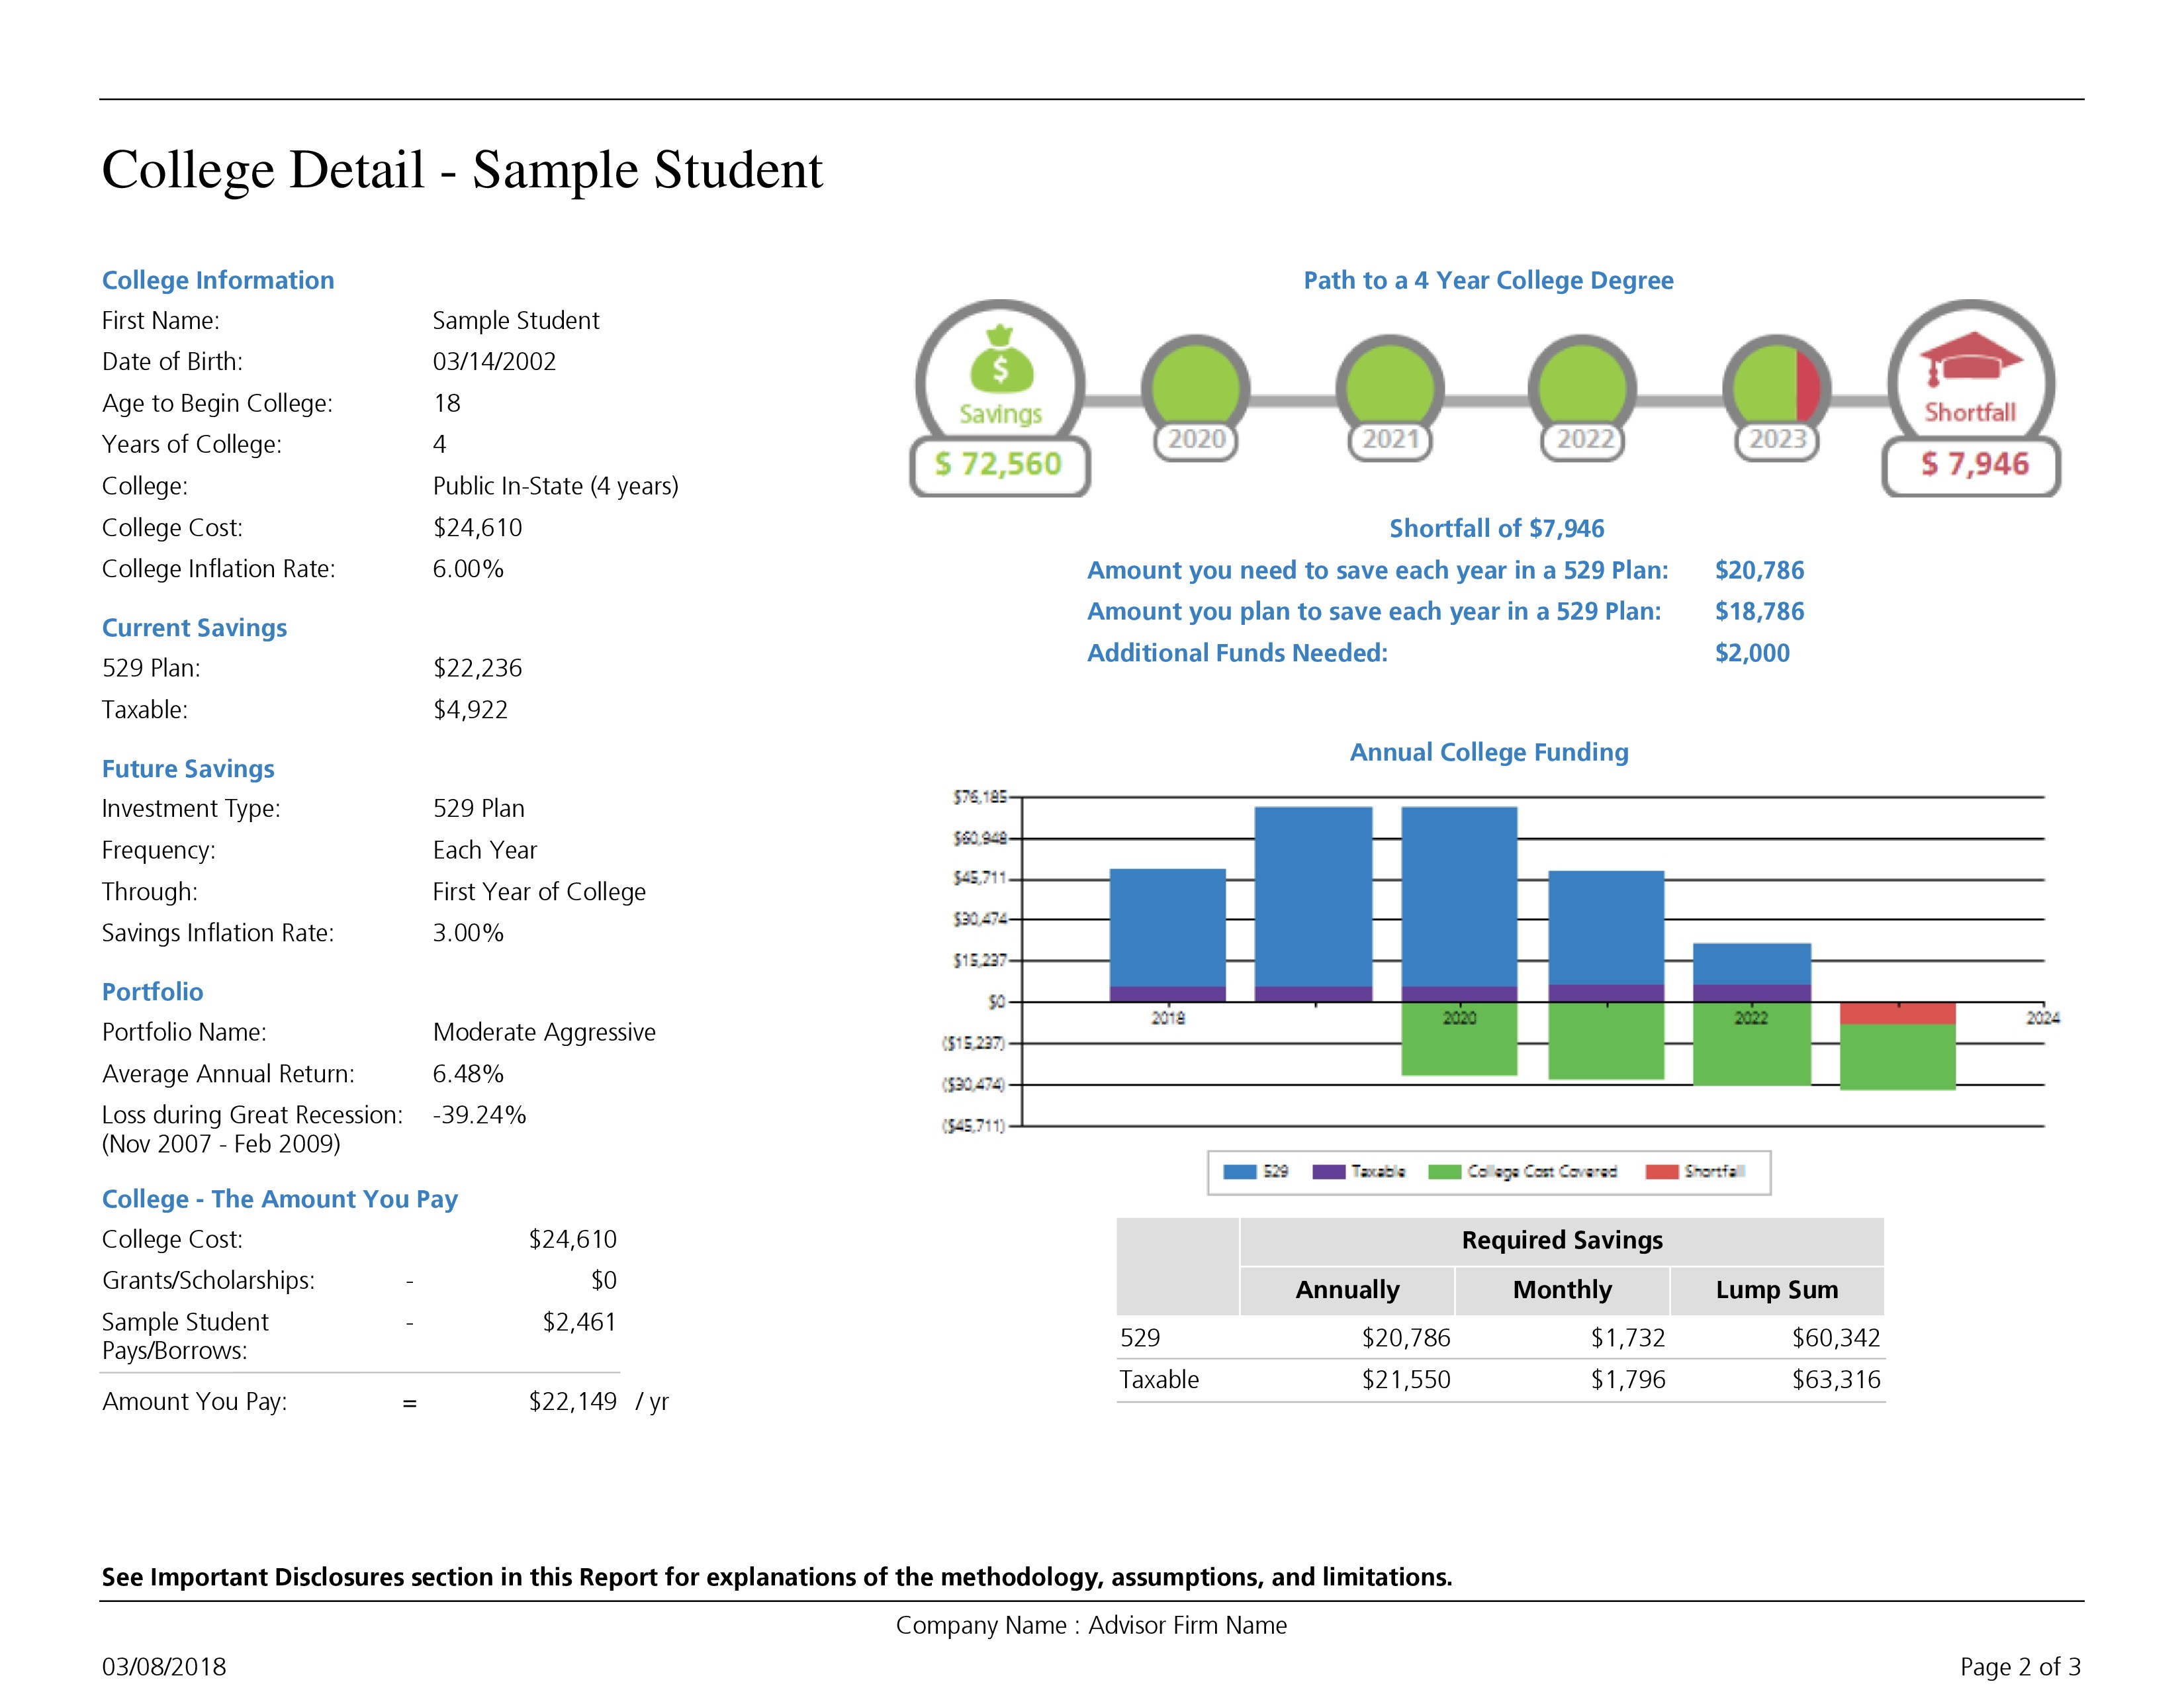
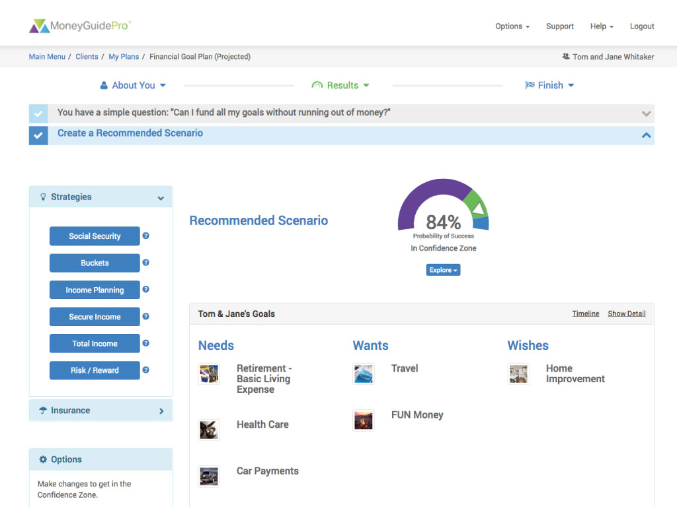
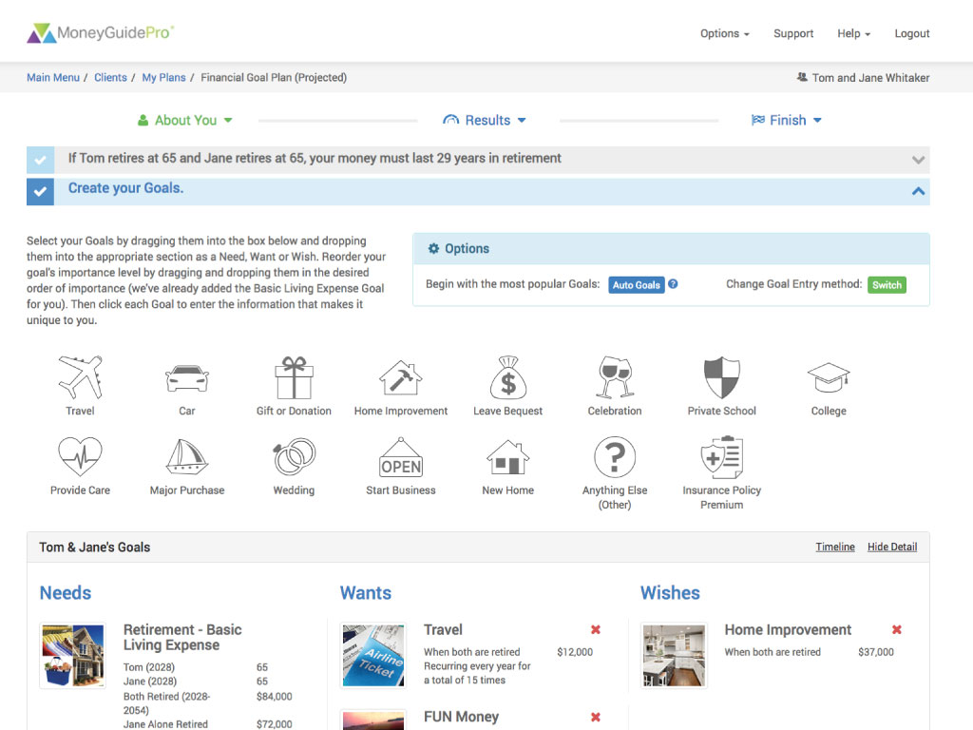
Life is full of decisions emanating from many different areas: charitable giving, education planning, investment planning, estate planning, retirement planning, social security claiming strategies, tax reduction, risk management, cash flow/income sourcing and more.
The complex nature of these initiatives and the way in which they are interlinked causes each one to have a significant impact on the other, which requires a comprehensive solution tailored specifically to the individual client. To help us achieve this, we utilize one of the industry’s leading financial planning software programs, MoneyGuidePro®.
This enhanced solution gives us the ability to offer varying degrees of plans ranging from a more targeted perspective focusing on specific areas such as retirement planning, college planning or Social Security planning to a more comprehensive approach, encompassing every area of your financial life. This tool affords our clients the ability to visually see the financial impact their decisions can have on their short and long-term goals, and ultimately overall financial future.
VISIT OUR WEBSITE TO LEARN MORE

Slide 9
Hope to hear from you soon!
CFP@mainstadvisors.com
https://www.mainstadvisors.com
410-840-9200

Slide 10
Thank you!
CC
Connect with us!
f
in
Hometown Service | Thoughtful Solutions | Powerful Results. We know it’s the little things that can make all the difference.
Main Street Advisors, LLC is a Registered Investment Advisor. The articles & opinions expressed in this material were gathered from multiple sources, but are reviewed by Main Street Advisors, LLC prior to its dissemination. All sources are believed to be reliable but do not constitute specific investment advice. The views expressed are those of the firm as of the date of the material being shared and are subject to change. These opinions are not intended to be a forecast of future events, a guarantee of results, or investment advice. Information shared is general in nature. Investors must consider their own individual circumstances and seek appropriate counsel from their investment advisor before making any investment choices. Main Street Advisors, LLC is not responsible for any damages or losses arising from any use of this information. Past performance is no guarantee of future results.

