Slide 1
Getting Started
We know it’s the little things that can make all the difference
A Guidebook for Those in the Accumulation Phase of Life
(Built for individuals in their 40’s & 50’s)

Slide 2
Where you Are
You’ve been in the workforce for quite some time and continue to grow your wealth. You have questions relating to properly preparing for retirement, investing mix and allocation, ROTH vs. traditional and more…

Slide 3
KNOW WHERE YOUR MONEY GOES
48% of Generation Xers say they are living paycheck to paycheck, and only 53% have three months worth of salary stashed away for emergency purposes, according to a Met Life survey.
55% feel significantly behind in their retirement savings timeline.
Of this surveyed group, the biggest sources of long-term financial concern are the ability to afford the cost of healthcare in retirement, outliving retirement savings, and the ability to rely on Social Security and Medicare.
When it comes to debt, Americans who belong to Gen X are carrying the most.
On average, Gen Xers (ages 39 to 54) have racked up $36,000 in personal debt, excluding home mortgages, according to Northwestern Mutual’s 2019 Planning & Progress Study. The findings are based on a survey conducted by The Harris Poll of over 2,000 U.S. adults.
According to a study from the Consumer Bankruptcy Project: Since 1991, the rate of people 65 and older filing for bankruptcy has tripled.
According to the Stanford Center of Longevity, nearly one-third of baby boomers had no money saved in retirement plans in 2014, when they were on average 58 years old, according to the researchers.
Use our cash flow template. Available upon request via phone call or email.

Slide 4
Track your progress year to year
Your net worth can be a great tool in gauging your overall financial progress from year to year.
Your net worth is the figure you get when you add up everything you own (value of your home to the cash in your bank account) and then subtract all your debts (this may include a mortgage, car or student loans and credit card balances).
Essentially, it is what you would have left if you sold everything you owned and paid off all of your debts.
To learn more CLICK HERE
Use our net worth template. Available upon request via phone call or email.

Slide 5
Financial goals & Milestones to aim for
forties
•Ensure you have eliminated all non-mortgage consumer debt.
•Have a plan for your kid’s college (perhaps open a 529 plan and make monthly automatic contributions). However, prioritize retirement savings first. Rule of thumb: multiply your child’s age by 2,000 and this is the amount you should have saved by now (assumes 4-year public college and covering half of the cost).
•Continue saving. Contribute 10-15% of your annual salary to your retirement accounts – 401(k), 403(b), IRAs.
•Have at least 2X – 3X your annual income in retirement savings.
•Consider the benefits of opening a ROTH IRA.
•Consider opening a taxable investment account that can be used in the early retirement years as your tax-deferred account.
•Avoid lifestyle inflation.
Other Helpful Resources
Financial Calculators
Recommended Reading
Web Resources

Slide 6
Financial goals & Milestones to aim for
•A rule of thumb is to save 4X to 5X your annual salary by the time you are in your 50’s for your retirement.
•Having an emergency fund in place to cover 3-6 months of essential living expenses.
•Consider meeting with a financial advisor to determine if your planned retirement date is feasible and whether your goals, needs, wants and wishes align with your current financial situation. Work with them to draft a retirement plan you can follow to keep you on track for achieving your retirement goals.
fifties
•Ensure you have eliminated all student loan debt.
•Review your life insurance options, and if you haven’t yet, consider purchasing some. This is a time in your life when you typically have a family to support, college obligations coming up or already in the mix and significant debts to cover. Also consider long-term care policy options.
•Have an estate plan in place. At the minimum, have a legally executed will and power of attorney. If you have a high-net-worth estate, consider discussing estate planning strategies such as trusts.
•Make sure you are maxing out your retirement contributions. Take advantage of catch-up contributions. You can contribute $6,500 more for 401(k)s for 2020 if you are 50 or older. Individual retirement contributions stay the same at $6,000 with a $1,000 catch-up limit for those 50 or older.
•Rid yourself of debt (credit cards, auto loans, other installment loans, in addition to mortgage debt). Being debt-free will lower your cost of living during retirement. Consider downsizing.
resources
Financial Calculators
Golden – An app to help manage your parents’ money/finances.
Medisafe – An app to help with medication reminders and alarms.

Slide 7
Financial goals & Milestones to aim for
sixties
•Look for ways to earn more income (selling stuff on Etsy, part-time side job) and continue to grow your nest egg.
•Review Social Security options and the upside of delaying benefits. Discuss with a financial advisor.
•Estimate healthcare costs for retirement (According to the Fidelity Retiree Health Care Cost Estimate, an average retired couple age 65 in 2019 may need about $285,000 saved (after tax) to cover health care expenses in retirement.
•Understand how you will be impacted by taxes. Discuss your specific situation with a CPA and financial advisor.
•Understand your options regarding Medicare/Medicaid and Medigap.
•Meet with your estate planning attorney and financial advisor at least annually to ensure documents, goals, investment allocations, beneficiaries, etc. are all up to date and reflecting your current wishes.
•Simplify. Consolidate accounts where prudent to do so.
resources
Social Security Calculator (Financial Engines)
Social Security Calculator (Open Social Security)
Medicare and You Handbook
Medicare Plan Finder
The State Health Insurance Assistance Program

Slide 8
Accumulator checklist
Insurance
Review life insurance and long-term care policy coverages and options.
Review your auto/home/umbrella policies annually.
Financial planning/investment planning
Consider hiring Main Street Advisors, LLC to help you create a financial plan or fine tune an existing one, navigate the financial markets, determine the most suitable Social Security claiming strategy for your situation, create a debt reduction plan and invest your money wisely.
Create a net worth sheet to track your financial progress from year to year.
Continue to grow your nest egg by investing in a 401(k), 403 (b) and/or IRA for retirement savings and take advantage of the catch-up contributions.
Ensure you have an emergency fund in place for 3-6 months of essential living expenses.
Educate yourself on important topics such as Medicare and Medicaid, as well as the impact of taxes as you age.
Estate planning
Secure a financial power of attorney, health power of attorney and last will and testament.

Slide 9
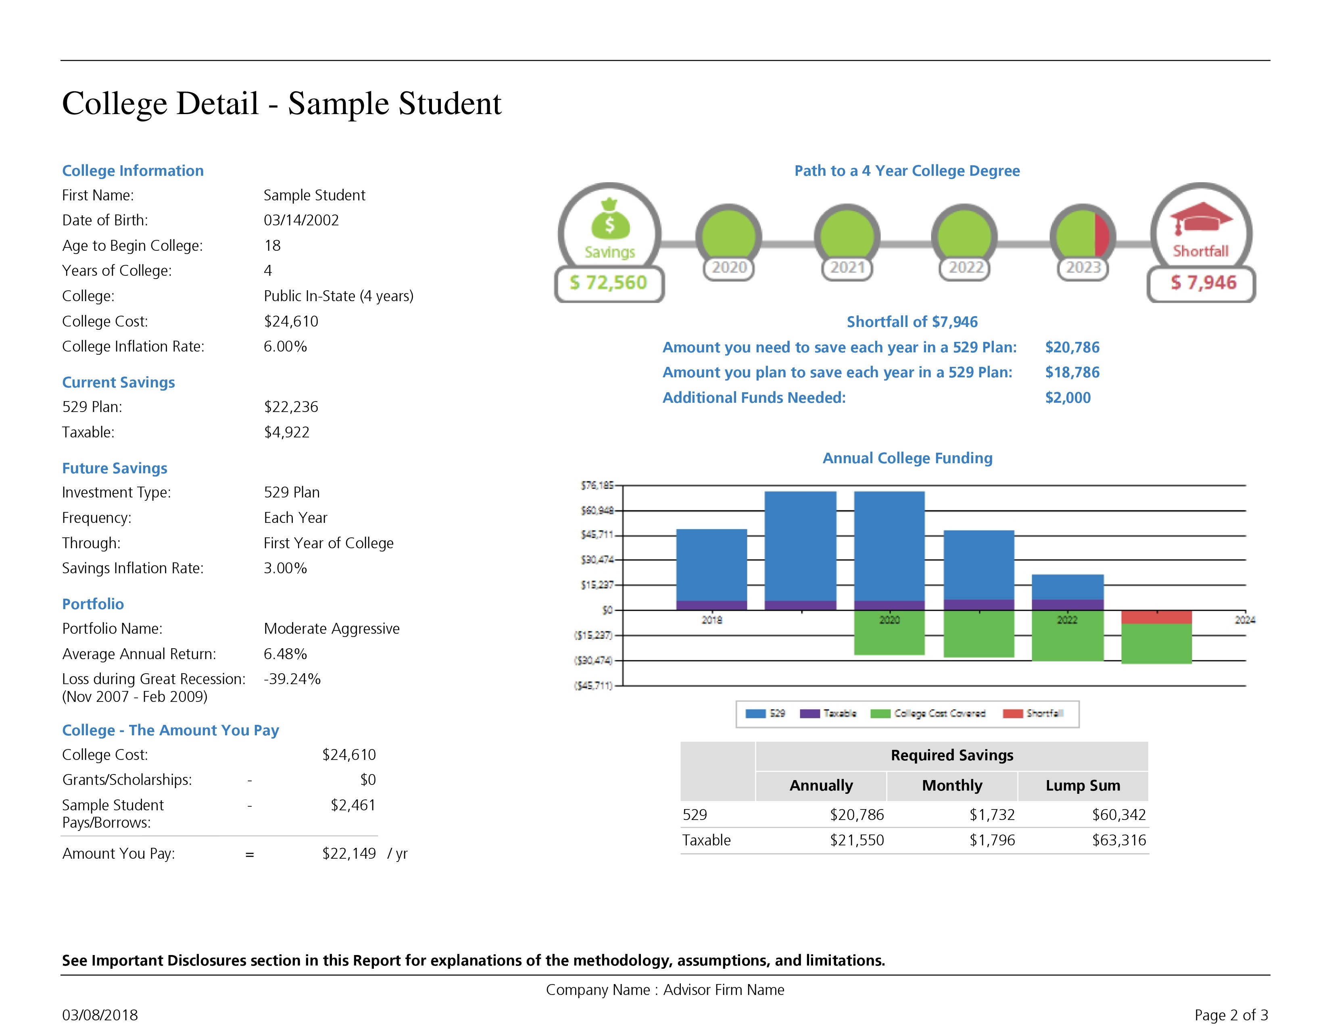
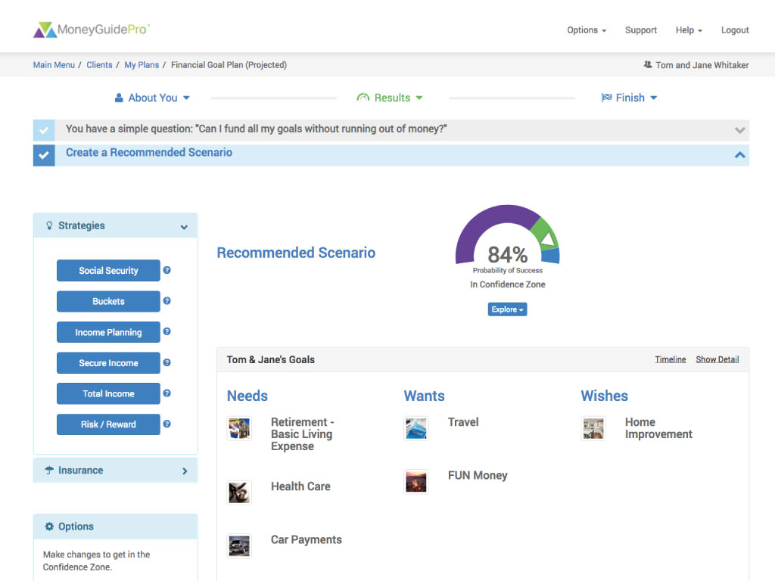
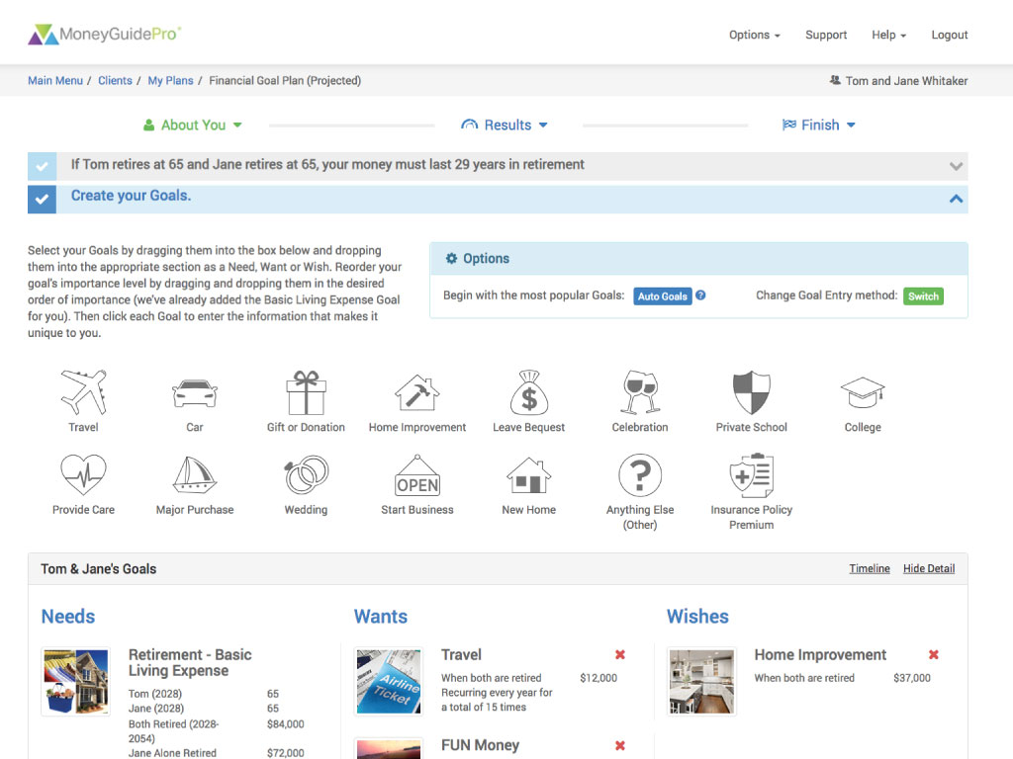
Life is full of decisions emanating from many different areas: charitable giving, education planning, investment planning, estate planning, retirement planning, social security claiming strategies, tax reduction, risk management, cash flow/income sourcing and more.
The complex nature of these initiatives and the way in which they are interlinked causes each one to have a significant impact on the other, which requires a comprehensive solution tailored specifically to the individual client. To help us achieve this, we utilize one of the industry’s leading financial planning software programs, MoneyGuidePro®.
This enhanced solution gives us the ability to offer varying degrees of plans ranging from a more targeted perspective focusing on specific areas such as retirement planning, college planning or social security planning to a more comprehensive approach, encompassing every area of your financial life. This tool affords our clients the ability to visually see the financial impact their decisions can have on their short and long-term goals, and ultimately overall financial future.
VISIT OUR WEBSITE TO LEARN MORE

Slide 10
Hope to hear from you soon!
CFP@mainstadvisors.com
https://www.mainstadvisors.com
410-840-9200

Slide 11
Thank you!
CC
Connect with us!
f
in
Hometown Service | Thoughtful Solutions | Powerful Results. We know it’s the little things that can make all the difference.
Main Street Advisors, LLC is a Registered Investment Advisor. The articles & opinions expressed in this material were gathered from multiple sources, but are reviewed by Main Street Advisors, LLC prior to its dissemination. All sources are believed to be reliable but do not constitute specific investment advice. The views expressed are those of the firm as of the date of the material being shared and are subject to change. These opinions are not intended to be a forecast of future events, a guarantee of results, or investment advice. Information shared is general in nature. Investors must consider their own individual circumstances and seek appropriate counsel from their investment advisor before making any investment choices. Main Street Advisors, LLC is not responsible for any damages or losses arising from any use of this information. Past performance is no guarantee of future results.

